Slide 1
AMAZON SALES REPORT
PREPARED BY AMAR SHILVANTH

Slide 2
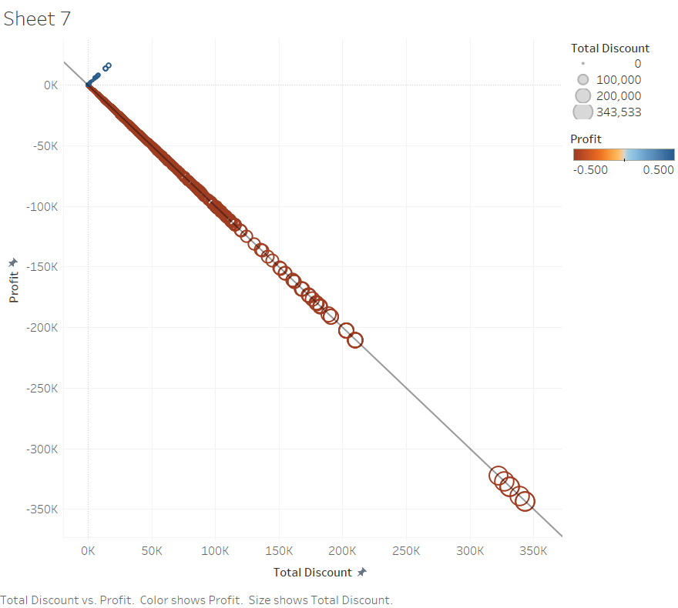
What is the Problem ?
In this Graph Colour is Being represented by the Profit and size is represented by Discount Here Profit & Discount Shows a Negative Correlation Which Means Larger Discounts affects the Profit

Slide 3
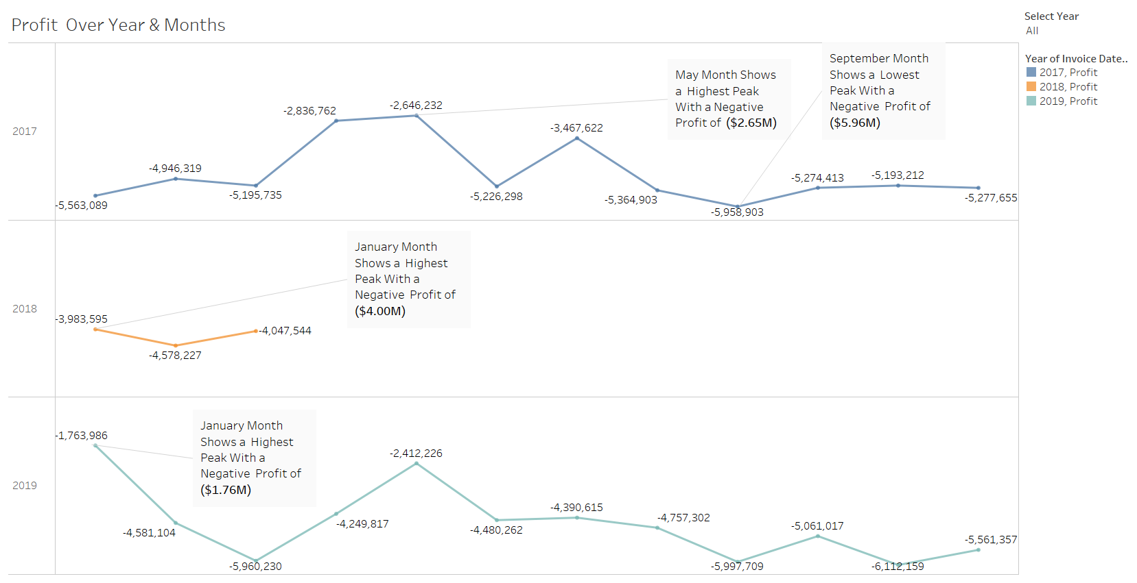
What are the Profits Over Year ?

Slide 4
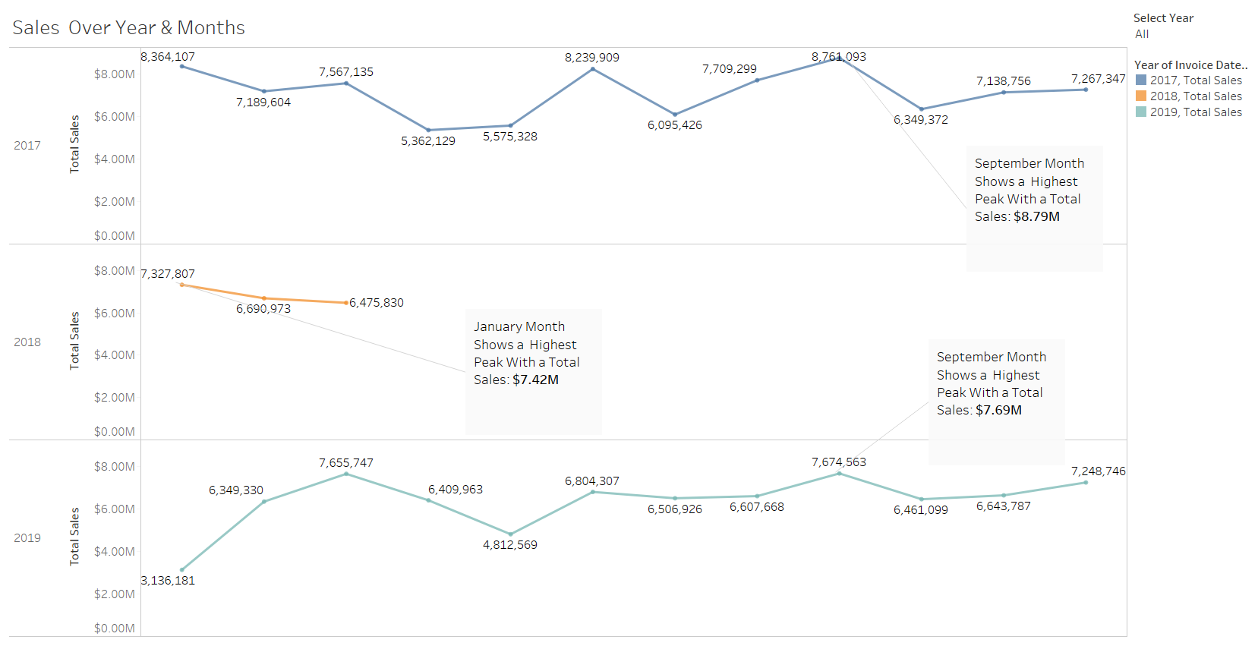
What are the Sales Over Year ?

Slide 5
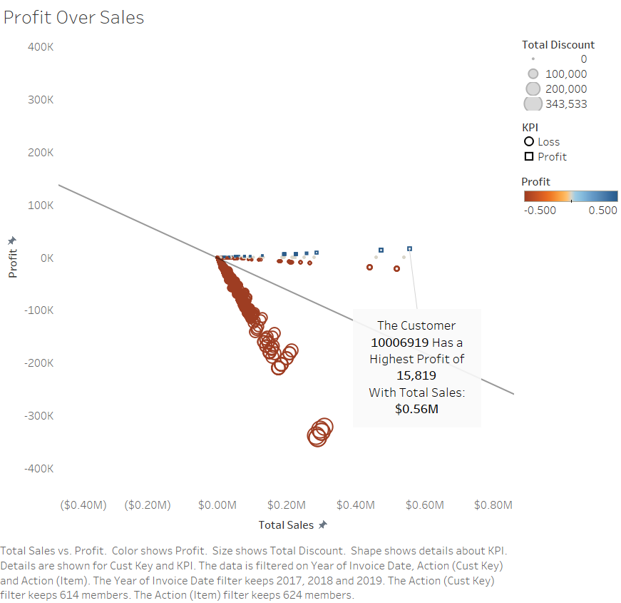
What is the relation between Profit & Sales ?
The Graph Shows Discounts Can Boost The Sales But It Affects The Profit
The Customer 10006919 Has a Highest Profit of $15819 With a Total Sales of $0.56M

Slide 6
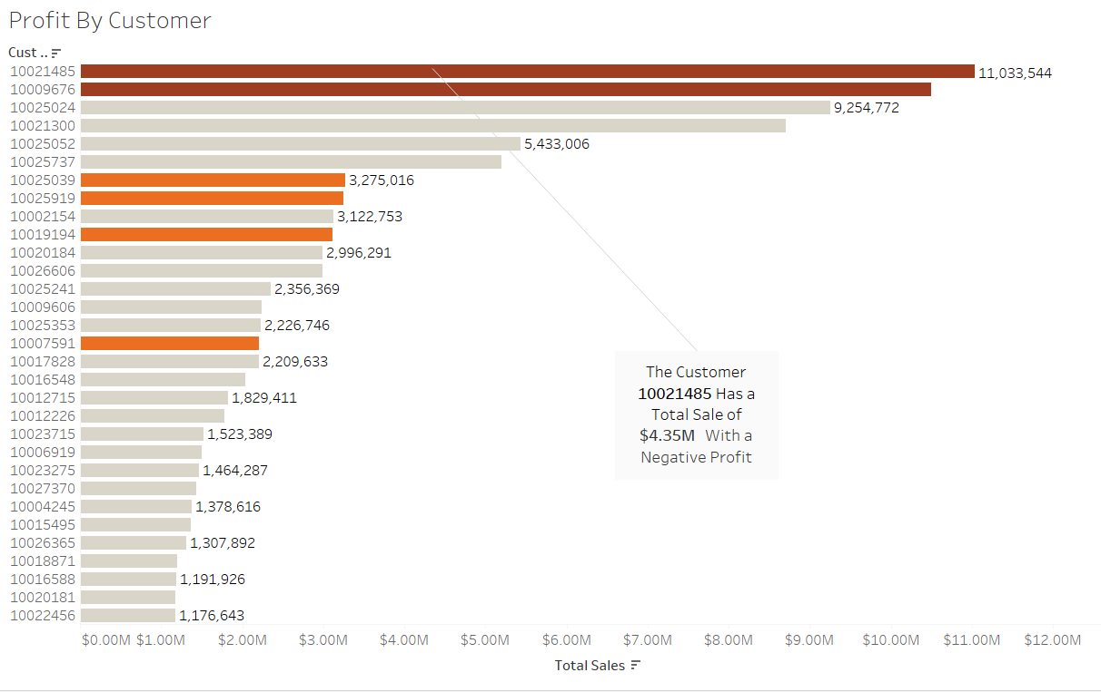
What is the relationship between Customer Profit & Sales ?
The Customer 10021485 Has the Highest Sale With Negative Profit

Slide 7
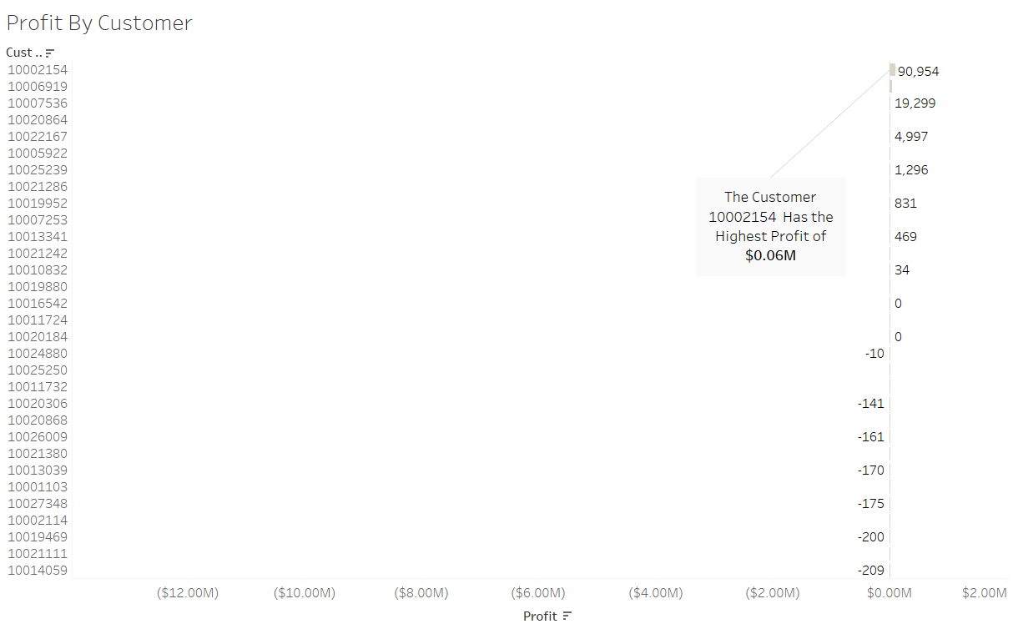
What is the relationship between Customer Profit & Sales ?
The Customer 10002154 Has the Highest Profit of $0.06M

Slide 8
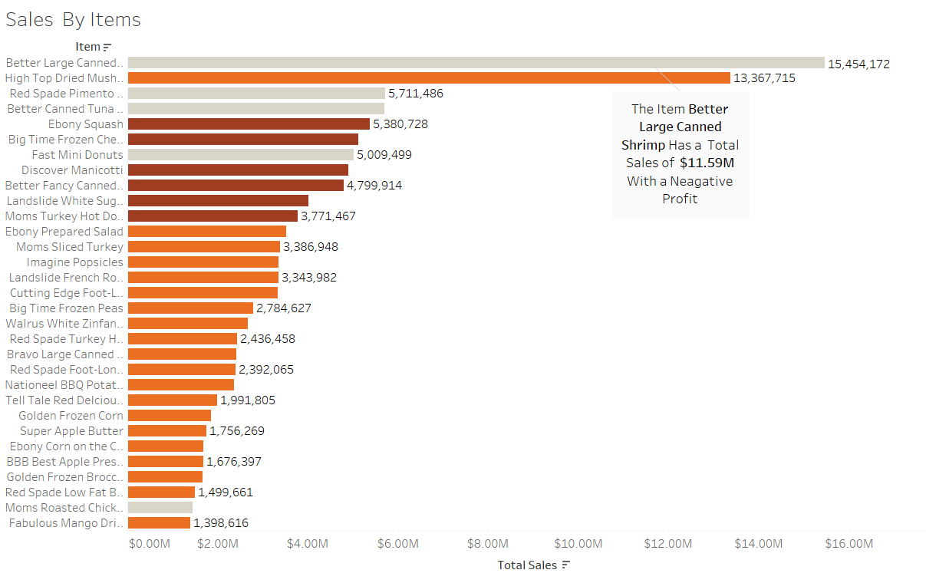
What is the relationship between Items Profit & Sales ?
Were as Better Large Canned & Shrimp is the Highest Selling Item With a Total Sales of $ 11.59

Slide 9
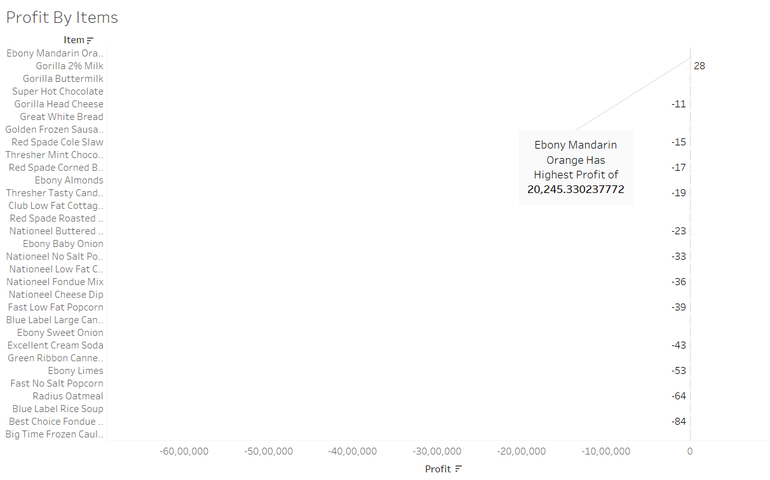
What is the relationship between Items Profit & Sales ?
Ebony Mandarin Orange is the Highest Profitable Item With a Total Profit of $ 20245.33

Slide 10
Recommendations & Suggestions
Decrease the Amount of Discount for Higher Profits
September & January Months are the Highest Selling Periods, Selling in this Period Makes Profitable for the Business.

Slide 11
THANK YOU

